Slide 1
LOADERS AND LINKERS
Module-4

Slide 2
Design of a Direct Linking Loader (DLL)
The direct linking loader is a re-locatable loader.

Slide 3
Design of a Direct Linking Loader (DLL)
The direct linking loader is a re-locatable loader.
The loader cannot have the direct access to the source code.

Slide 4
Design of a Direct Linking Loader (DLL)
The direct linking loader is a re-locatable loader.
The loader cannot have the direct access to the source code.
To place the object code in the memory there are two situations:
The address of the object code could be absolute: Directly place code at specified location
The address can be relative.
If at all the address is relative, then it is the assembler who informs the loader about the relative addresses.

Slide 5
Design of a Direct Linking Loader (DLL)
The direct linking loader is a re-locatable loader.
The loader cannot have the direct access to the source code.
To place the object code in the memory there are two situations:
The address of the object code could be absolute: Directly place code at specified location
The address can be relative.
If at all the address is relative, then it is the assembler who informs the loader about the relative addresses.

Slide 6
Specification of problem
The assembler should give the following information to the loader
The length of the object code segment

Slide 7
Specification of problem
The assembler should give the following information to the loader
The length of the object code segment
The list of all the symbols, which are not defined in the current segment but can be used in the current segment.

Slide 8
Specification of problem
The assembler should give the following information to the loader
The length of the object code segment
The list of all the symbols, which are not defined in the current segment but can be used in the current segment.
The list of all the symbols, which are defined in the current segment but can be referred by the other segments.

Slide 9
Specification of Data Structures
Identify the data bases required by each pass of the loader:
Pass 1 data bases:
Input object decks.

Slide 10
Specification of Data Structures
Identify the data bases required by each pass of the loader:
Pass 1 data bases:
Input object decks.
A parameter, the Initial Program Load Address (IPLA) supplied by the programmer or the operating system, that specifies the address to load the first segment.

Slide 11
Specification of Data Structures
Identify the data bases required by each pass of the loader:
Pass 1 data bases:
Input object decks.
A parameter, the Initial Program Load Address (IPLA) supplied by the programmer or the operating system, that specifies the address to load the first segment.
A Program Load Address (PLA) counter, used to keep track of each segment's assigned location

Slide 12
Specification of Data Structures
Pass 1 data bases:
4. A table, the Global External Symbol Table (GEST), that is used to store each external symbol and its corresponding assigned core address.

Slide 13
Specification of Data Structures
Pass 1 data bases:
4. A table, the Global External Symbol Table (GEST), that is used to store each external symbol and its corresponding assigned core address.
5. A copy of the input to be used later by pass 2.
This may be stored on an auxiliary storage device, such as magnetic tape, disk, or drum, or the original object decks may be reread by the loader a second time for pass 2.

Slide 14
Specification of Data Structures
Pass 1 data bases:
4. A table, the Global External Symbol Table (GEST), that is used to store each external symbol and its corresponding assigned core address.
5. A copy of the input to be used later by pass 2.
This may be stored on an auxiliary storage device, such as magnetic tape, disk, or drum, or the original object decks may be reread by the loader a second time for pass 2.
6. A printed listing, the load map, that specifies each external symbol and its assigned value.

Slide 15
Specification of Data Structures
Pass 2 data bases:
Copy of object programs inputted to pass I

Slide 16
Specification of Data Structures
Pass 2 data bases:
Copy of object programs inputted to pass I
The Initial Program Load Address parameter (IPLA)

Slide 17
Specification of Data Structures
Pass 2 data bases:
Copy of object programs inputted to pass I
The Initial Program Load Address parameter (IPLA)
The Program Load Address counter (PLA)

Slide 18
Specification of Data Structures
Pass 2 data bases:
Copy of object programs inputted to pass I
The Initial Program Load Address parameter (IPLA)
The Program Load Address counter (PLA)
The Global External Symbol Table (GEST), prepared by pass I, containing each external symbol and its corresponding absolute address value

Slide 19
Specification of Data Structures
Pass 2 data bases:
Copy of object programs inputted to pass I
The Initial Program Load Address parameter (IPLA)
The Program Load Address counter (PLA)
The Global External Symbol Table (GEST), prepared by pass I, containing each external symbol and its corresponding absolute address value
An array, the Local External Symbol Array (LESA), which is used to establish a correspondence between the ESD ID numbers, used on ESD and RLD cards, and the corresponding external symbol's absolute address value

Slide 20
Format of databases
Object Deck
External Symbol Dictionary cards (ESD)
Instructions and data cards, called "text" of program (TXT)
Relocation and Linkage Directory cards (RLD)
End card (END)
End of File (EOF)/ Loader Terminate(LDT)
Global External Symbol Table(GEST)
Local External Symbol Array (LESA)

Slide 21
Object deck
Direct Linking Loader uses four types of records in the object decks (files) which contains all information needed for relocation and linking.
These four sections are:
External Symbol Dictionary cards (ESD)
Instructions and data cards, called "text" of program (TXT)
Relocation and Linkage Directory cards (RLD)
End card (END)

Slide 22
External Symbol Dictionary cards (ESD)
The ESD cards contain the information necessary to build the external symbol dictionary or symbol table.

Slide 23
External Symbol Dictionary cards (ESD)
The ESD cards contain the information necessary to build the external symbol dictionary or symbol table.
External symbols are symbols that can be referred beyond the subroutine level.

Slide 24
External Symbol Dictionary cards (ESD)
The ESD cards contain the information necessary to build the external symbol dictionary or symbol table.
External symbols are symbols that can be referred beyond the subroutine level.
The normal labels in the source program are used only by the assembler, and information about them is not included in the object deck.

Slide 25
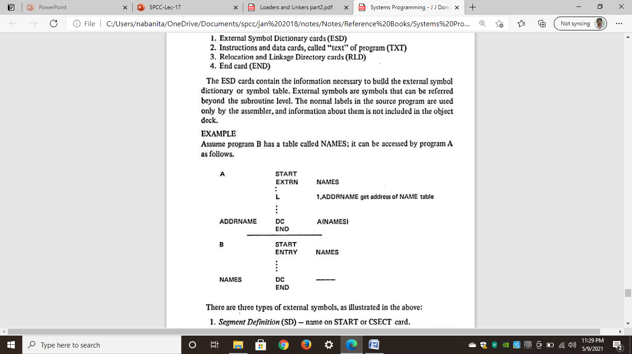
External Symbol Dictionary cards (ESD)
Example: Assume program B has a table called NAMES; it can be accessed by program A as follows.

Slide 26
External Symbol Dictionary cards (ESD)
There are three types of external symbols:
Segment Definition (SD): name on START or CSECT card.
Local Definition (LD): specified on ENTRY card. There must be a label in same program with same name. ·
External Reference (ER): specified on EXTRN card. There must be a corresponding ENTRY, START, or CSECT card in another program with same name.

Slide 27
External Symbol Dictionary cards (ESD)
There are three types of external symbols:
Segment Definition (SD): name on START or CSECT card.
Local Definition (LD): specified on ENTRY card. There must be a label in same program with same name. ·
External Reference (ER): specified on EXTRN card. There must be a corresponding ENTRY, START, or CSECT card in another program with same name.
Each SD and ER symbol is assigned a unique number (e.g., 1,2,3, ... ) by the assembler.

Slide 28
External Symbol Dictionary cards (ESD)
There are three types of external symbols:
Segment Definition (SD): name on START or CSECT card.
Local Definition (LD): specified on ENTRY card. There must be a label in same program with same name. ·
External Reference (ER): specified on EXTRN card. There must be a corresponding ENTRY, START, or CSECT card in another program with same name.
Each SD and ER symbol is assigned a unique number (e.g., 1,2,3, ... ) by the assembler.
This number is called the symbol's identifier, or ID, and is used in conjunction with the RLD cards.

Slide 29
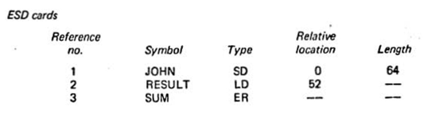
External Symbol Dictionary cards (ESD)
Example:

Slide 30
TXT Cards: "text" of program
Instructions and data cards, called "text" of program (TXT)

Slide 31
TXT Cards: "text" of program
Instructions and data cards, called "text" of program (TXT)
The TXT cards contain blocks of data and the relative address at which the data is to be placed.

Slide 32
TXT Cards: "text" of program
Instructions and data cards, called "text" of program (TXT)
The TXT cards contain blocks of data and the relative address at which the data is to be placed.
Once the loader has decided where to load the program, it merely adds the Program Load Address (PLA) to the relative address and moves the data into the resulting location.

Slide 33
TXT Cards: "text" of program
Instructions and data cards, called "text" of program (TXT)
The TXT cards contain blocks of data and the relative address at which the data is to be placed.
Once the loader has decided where to load the program, it merely adds the Program Load Address (PLA) to the relative address and moves the data into the resulting location.
The data on the TXT card may be instructions, non-relocated data, or initial values of address constants

Slide 34
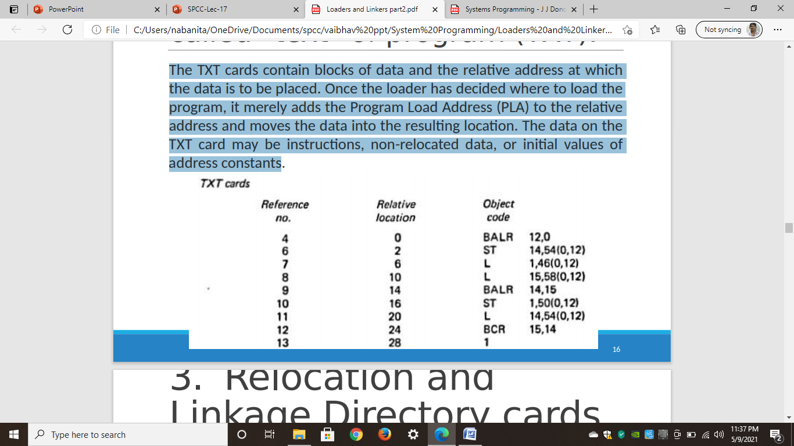
Instructions and data cards, called "text" of program (TXT):
The data on the TXT card may be instructions, non-relocated data, or initial values of address constants

Slide 35
Relocation and Linkage Directory cards (RLD):
The RLD cards contain the following information.
The location and length of each address constant that needs to be changed for relocation or linking

Slide 36
Relocation and Linkage Directory cards (RLD):
The RLD cards contain the following information.
The location and length of each address constant that needs to be changed for relocation or linking
The external symbol by which the address constant should be modified (added or subtracted)

Slide 37
Relocation and Linkage Directory cards (RLD):
The RLD cards contain the following information.
The location and length of each address constant that needs to be changed for relocation or linking
The external symbol by which the address constant should be modified (added or subtracted)
The operation to be performed (add or subtract)

Slide 38
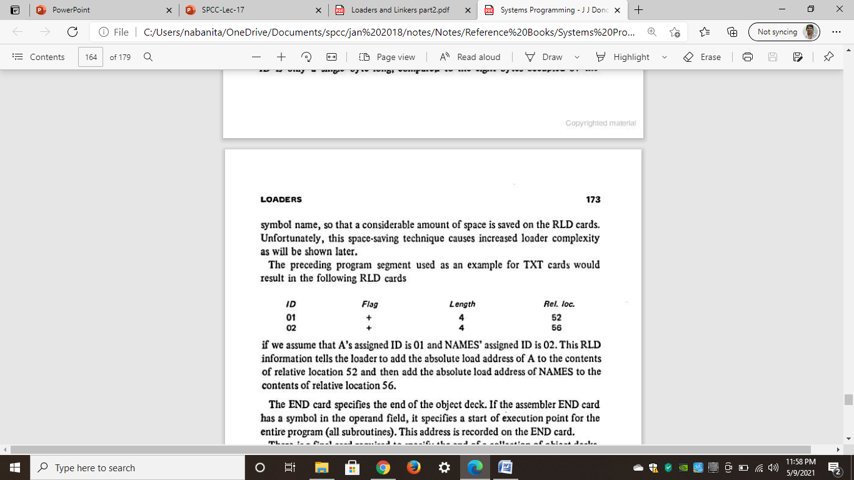
Relocation and Linkage Directory cards (RLD):
Example:
If we assume that A's assigned ID is 01 and NAMES' assigned ID is 02.
This RLD information tells the loader to add the absolute load address of A to the contents of relative location 52 and then add the absolute load address of NAMES to the contents of relative location 56.

Slide 39
End card (END)
The END card specifies the end of the object deck.

Slide 40
End card (END)
The END card specifies the end of the object deck.
If the assembler END card has a symbol in the operand field, it specifies a start of execution point for the entire program (all subroutines).

Slide 41
End card (END)
The END card specifies the end of the object deck.
If the assembler END card has a symbol in the operand field, it specifies a start of execution point for the entire program (all subroutines).
This address is recorded on the END card.

Slide 42
End of File (EOF) / Loader Terminate (LDT)
There is a final card required to specify the end of a collection of object decks.
The loaders usually use either a loader terminate (LDT) or End of File (EOF) card.

Slide 43
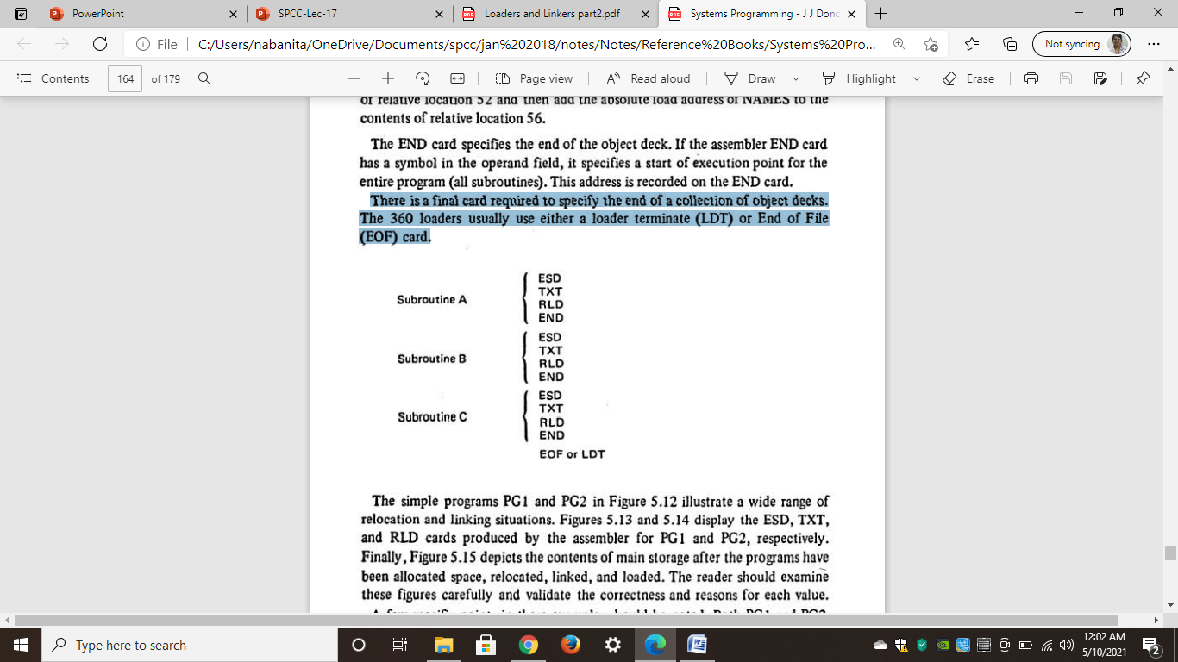
End of File (EOF) / Loader Terminate(LDT)
Example:

Slide 44
Global External Symbol Table (GEST)
The Global External Symbol Table (GEST) is used to store the external symbols.

Slide 45
Global External Symbol Table (GEST)
The Global External Symbol Table (GEST) is used to store the external symbols.
These symbols are defined by means of a Segment Definition (SD) or Local Definition (LD) entry on an External Symbol Dictionary (ESD) card.

Slide 46
Global External Symbol Table (GEST)
The Global External Symbol Table (GEST) is used to store the external symbols.
These symbols are defined by means of a Segment Definition (SD) or Local Definition (LD) entry on an External Symbol Dictionary (ESD) card.
When these symbols are encountered during pass 1, they are assigned an absolute core address

Slide 47
Global External Symbol Table (GEST)
The Global External Symbol Table (GEST) is used to store the external symbols.
These symbols are defined by means of a Segment Definition (SD) or Local Definition (LD) entry on an External Symbol Dictionary (ESD) card.
When these symbols are encountered during pass 1, they are assigned an absolute core address
This address is stored, along with the symbol, in the GEST

Slide 48
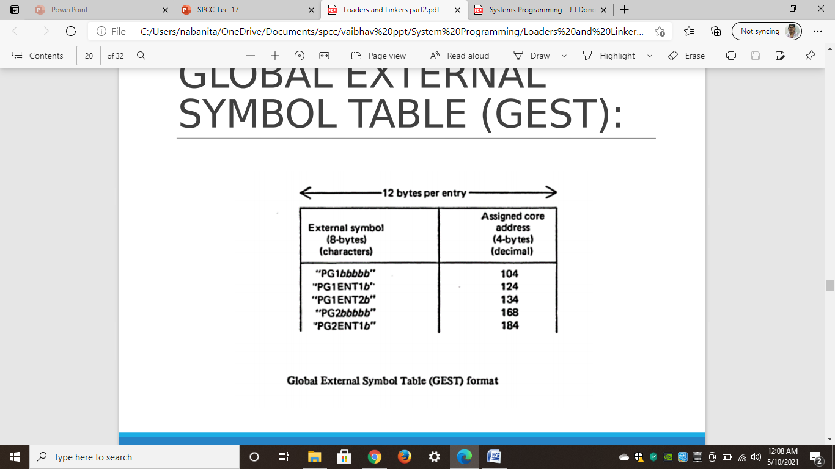
Global External Symbol Table (GEST)
Example:

Slide 49
LOCAL EXTERNAL SYMBOL ARRAY
It is necessary to create a separate LESA for each segment, but since the LESAs are only produced one at a time, the same array can be reused for each segment.
It is not necessary to search the LESA;
Given an ID number, the corresponding value is written as LESA(ID) and can be immediately obtained.

Slide 50
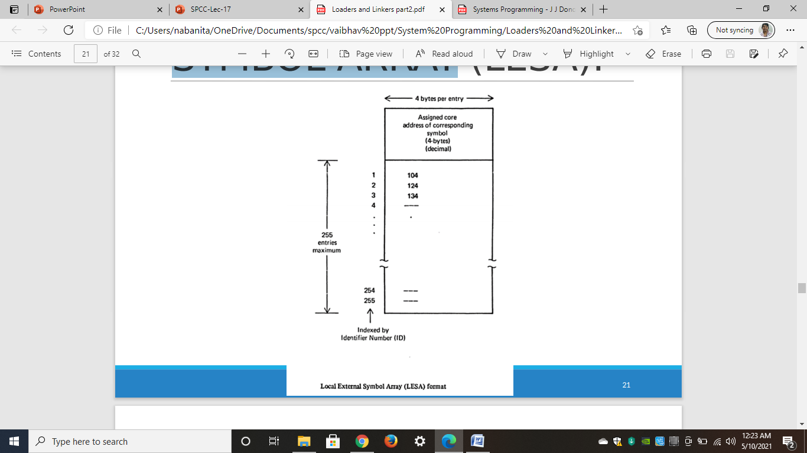
LOCAL EXTERNAL SYMBOL ARRAY
Example:

Slide 51
Algorithm
Pass 1:
Allocate segments and define symbols
Function:
Assign a location to each segment
Define the values of all external symbols

Slide 52
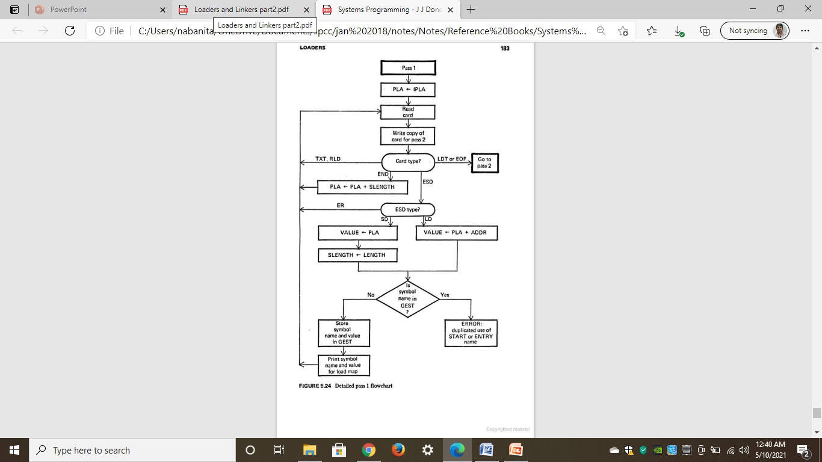
Flowchart for Pass-1

Slide 53
Algorithm
Pass 2:
Load Text and Relocate/Link Address content
Functions:
Complete the loading process by loading the text and adjusting (Relocation or Linking) address constant

Slide 54
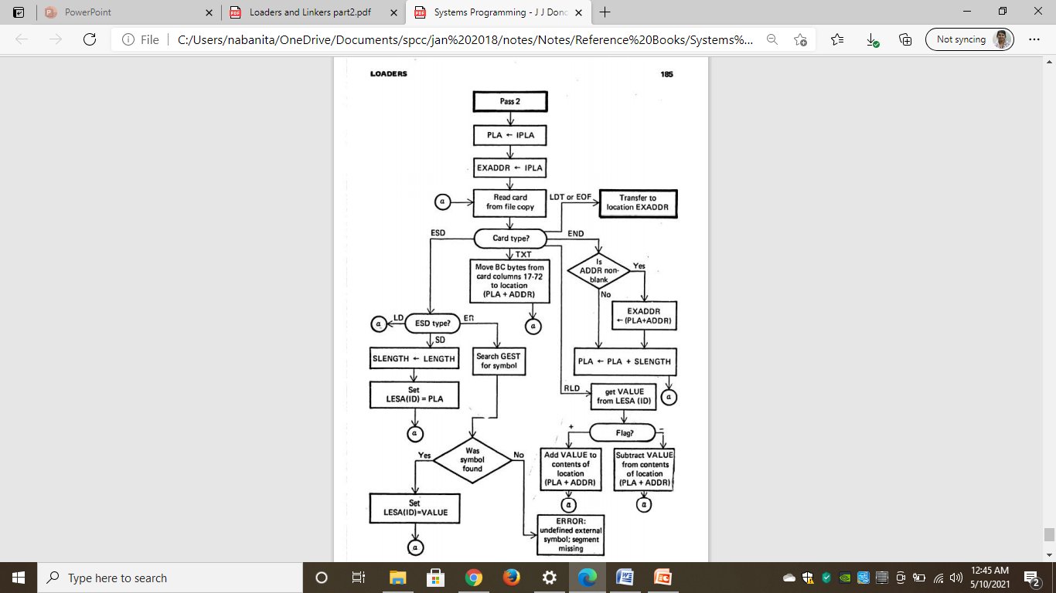
Flowchart for Pass-2

Slide 55
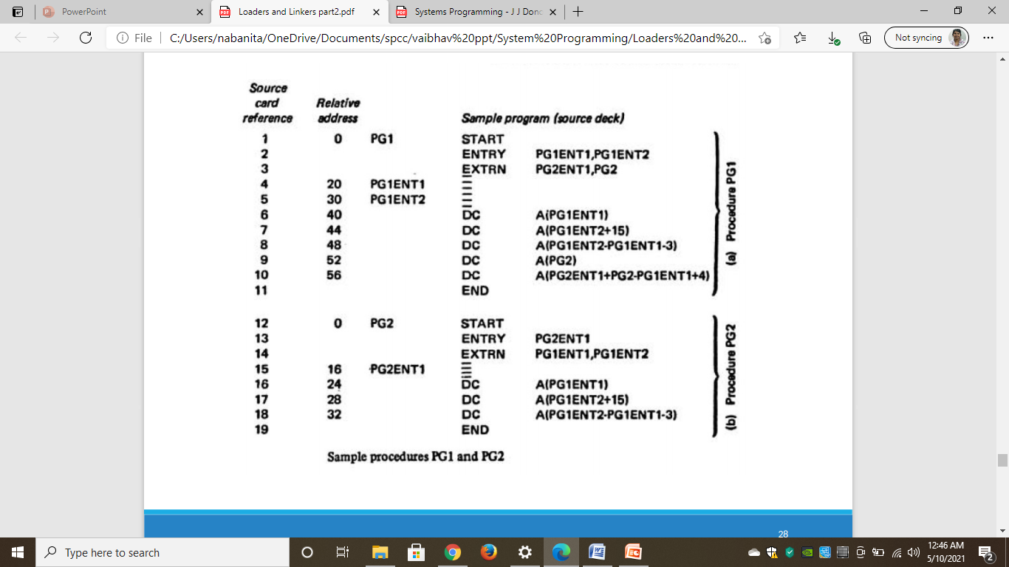
Example

Slide 56
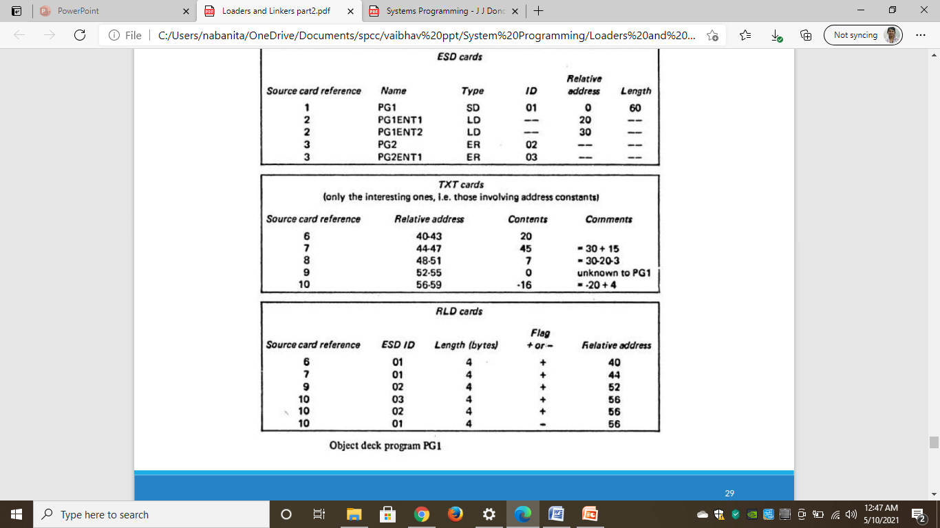
Example

Slide 57
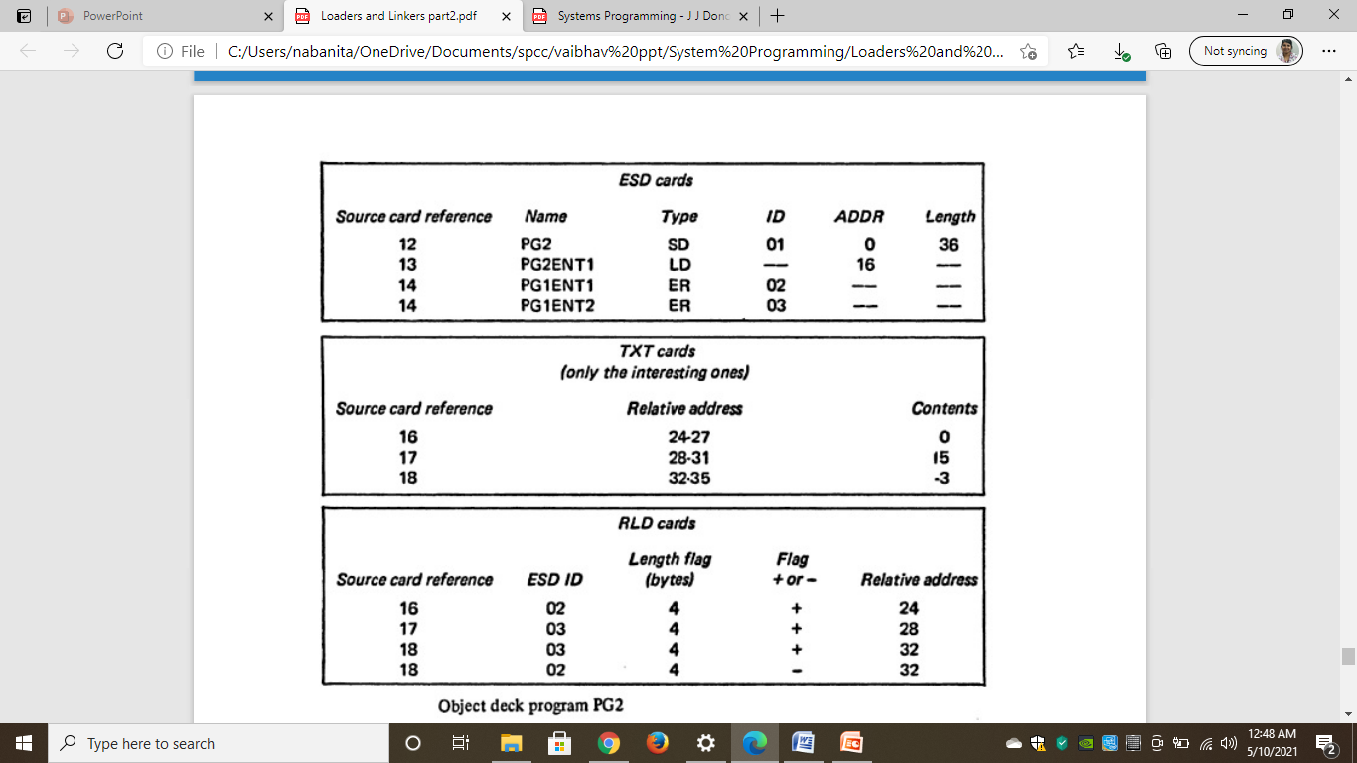
Example

Slide 58
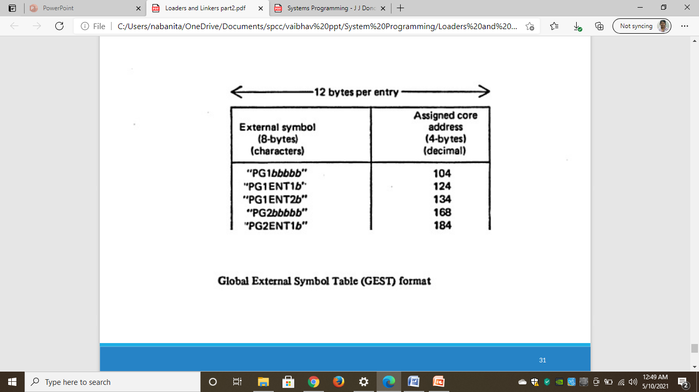
Example

Slide 59
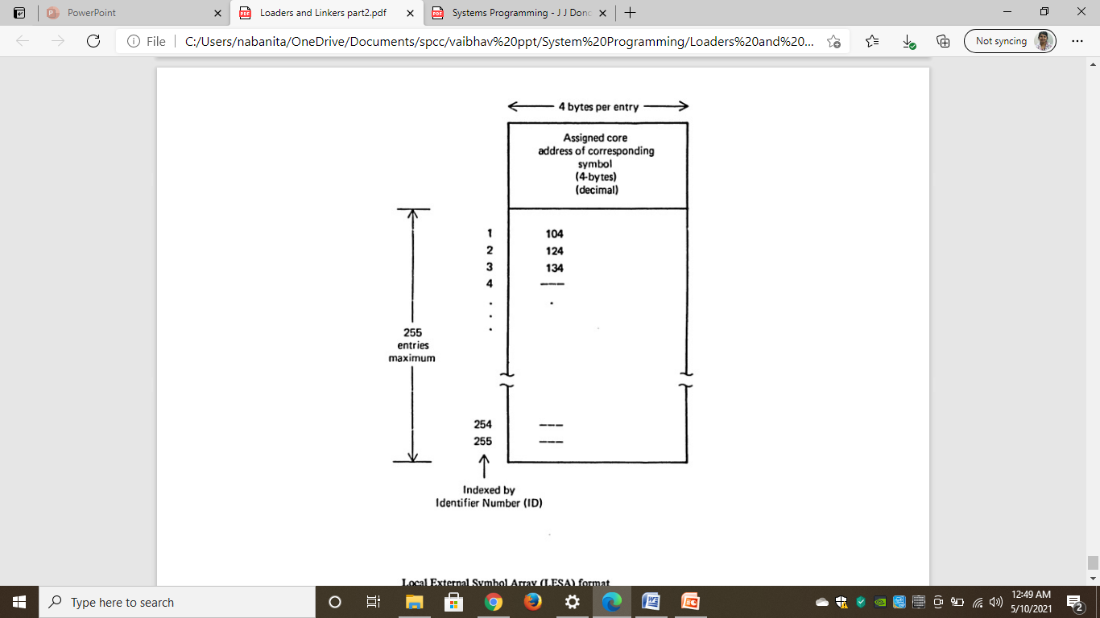
Example

